Slide 1
SystemVerilog HDL Workshop #1
044252 - Digital Systems and Computer Structure

Slide 2
Agenda
Hardware Description Languages
SystemVerilog Building Blocks:
Modules
The logic data type
Vectors
Module implementation
Module instantiation
Test benches and simulation

Slide 3
Agenda
Hardware Description Languages
SystemVerilog Building Blocks:
Modules
The logic data type
Vectors
Module implementation
Module instantiation
Test benches and simulation

Slide 4
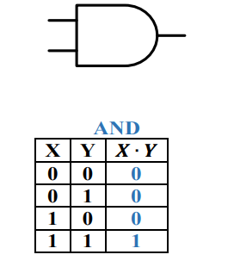
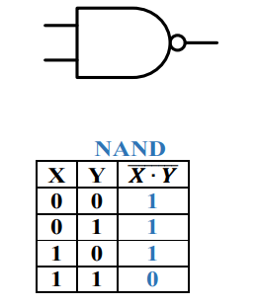
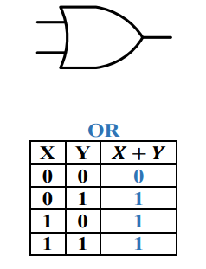
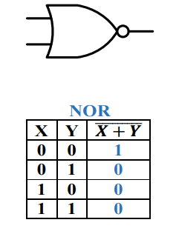


Logic Gates – A Reminder

Slide 5
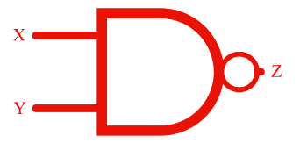
Ways to Represent Hardware:
Truth table
Schematic drawing
X | Y | Z
0 | 0 | 1
0 | 1 | 1
1 | 0 | 1
1 | 1 | 0
Hardware Description Language
Netlist
logic Z;
assign Z = X ~& Y;
nand(Z, X, Y);
logic Z;
always_comb
if (X) Z = ~Y;
else Z = 1;

Slide 6
Hardware Description Languages (HDLs)
Textual representation of digital circuits
HDLs are not “programming languages”
No, really. Even if they look like it, they are not.
Similar development chain to software
Software: Compiler
Source code ➔ Assembly code ➔ Machine code
Hardware: Synthesizer
HDL Source ➔ Netlist ➔ Hardware

Slide 7

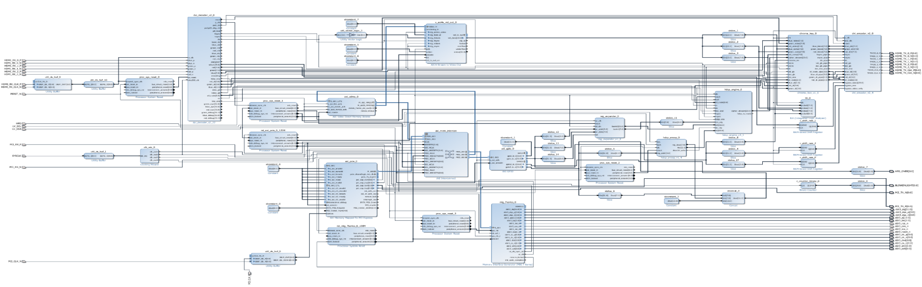
Why Use an HDL?
Easy to write and edit
Compact
Don’t have to follow a maze of lines
Easy to analyze with various tools

Slide 8
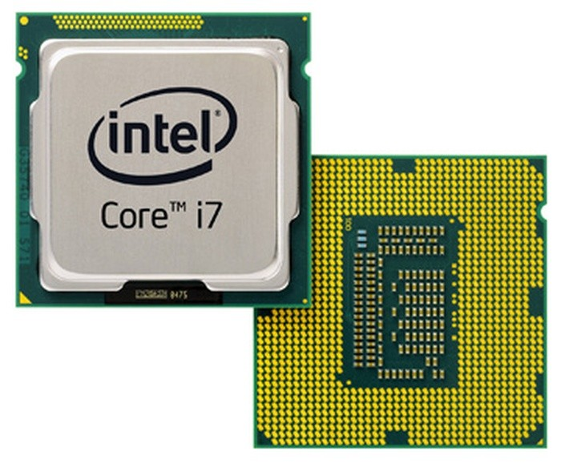
SystemVerilog
Superset of Verilog
One of the two leading HDLs - VHDL is the other.
Most digital chips are designed in part using one of these two languages

Slide 9
Agenda
Hardware Description Languages
SystemVerilog Building Blocks:
Modules
The logic data type
Vectors
Module implementation
Module instantiation
Test benches and simulation

Slide 10
Modules
module: fundamental building block
Describes a digital circuit
Hierarchical modules contain (instantiate) other modules
in1
my_module
out1
in2
out2
f
inN
outM
Everything you write in SystemVerilog must be inside a module!

Slide 11
Modules
Module Name
module my_module(
output logic out1,
output logic out2,
...,
input logic inN
);
... // declarations
... // description of f
endmodule
Input and Output Declaration
Module Start & End
in1
my_module
out1
in2
f
out2
inN
outM
No ; !

Slide 12
Agenda
Hardware Description Languages
SystemVerilog Building Blocks:
Modules
The logic data type
Vectors
Module implementation
Module instantiation
Test benches and simulation

Slide 13
The Logic Data Type
The logic data type represents a wire (1 bit)
Declaring a logic variable:
a
c
b
e
d
logic a, b, c, d; logic e;

Slide 14
The Logic Data Type
In this course, we will use the logic data type
More data types in SystemVerilog (not recommended!)
wire
reg
integer
time
More…
logic type replaces both wire and reg

Slide 15
SystemVerilog Logic Values
0: zero / logic low / false / ground
1: one / logic high / true / power
x: not initialized or collision
z: unconnected

Slide 16
Reminder: 4→1 Selector /Multiplexer / Mux
Input: | 2 Control inputs
 | 2² Data inputs
 | Enable input
Output: | if E=0 then ‘0’
 | else D_{S}
O
E
How to represent several bits?

Slide 17
Agenda
Hardware Description Languages
SystemVerilog Building Blocks:
Modules
The logic data type
Vectors
Module implementation
Module instantiation
Test benches and simulation

Slide 18
Vectors
Declaration of an 8-bit logic vector:
Exercise: write a mux module declaration
logic [7:0] w1; // w1[7] is the MSB
O

Slide 19
Mux Module Declaration - Solution
module mux4to1(
output logic O,
input logic D0,
input logic D1,
input logic D2,
input logic D3,
input logic E,
input logic [1:0] S
);
... // declarations
... // description of a mux
endmodule
O

Slide 20
Vector Operations
Bit select:
Range select:
Pack:
Unpack:
w1[3]
w1[3:2]
vec = {x, y, z};
{carry, sum} = vec[1:0];

Slide 21
Vectors - Exercise
Swap high and low nibbles of w1 into w2
Solution:
logic [7:0] w1; logic [7:0] w2;
w2 = {w1[3:0], w1[7:4]};

Slide 22
Intro – 2’s complement
N-bit Unsigned binary:
N-bit Signed binary:
The only difference is the MSB changes to a negative value!
Example: 1010 Example: 11010
Unsigned: 8+2 = 10 Unsigned: 16+8+2 = 26
Signed: -8+2 = -6 Signed: -16+8+1 = -6
$$2^{N−1}$$ | $$2^{N−2}$$ | $$2^{N−3}$$ |  |  |  |  | $$2^{2}$$ | $$2^{1}$$ | $$2^{0}$$
$${−2}^{N−1}$$ | $$2^{N−2}$$ | $$2^{N−3}$$ |  |  |  |  | $$2^{2}$$ | $$2^{1}$$ | $$2^{0}$$

Slide 23
Repeated Signals
Previously we discussed vector concatenation:
We can also repeat a signal n times:
vec = {x, y, z};
vec = {16{x}}; // 16 copies of x

Slide 24
Repeated Signals - Example
Question: What does this do?
Answer: Unsigned extension
Question: What about this?
Answer: Signed extension
logic [7:0] out; logic [3:0] A; out = {{4{0}}, A[3:0]};
out = {{4{A[3]}}, A[3:0]};

Slide 25
Agenda
Hardware Description Languages
SystemVerilog Building Blocks:
Modules
The logic data type
Vectors
Module implementation
Module instantiation
Test benches and simulation

Slide 26
Module Implementation
There are 3 ways to implement hardware inside a module:
Module instantiation
Concurrent assignments
Procedural blocks

Slide 27
Module Instantiation
Implementing a module using other modules as building blocks
My Module
input1
output1
Module
Building Block #1
Module
Building Block #2

Slide 28

Module Instantiation
Implementing a module using other modules as building blocks

Slide 29
Module Instantiation Syntax
Instance name
Positional association:
Named association:
Module name
module_name instance_name1 (
my_out1,
my_out2,
...,
my_inN
);
Input and Output port assignments
Instance name
Module name
module_name instance_name2 (
.out1(my_out1),
.out2(my_out2),
...,
.inN(my_in1)
);
Wire name
Module port name
044252 - Digital Systems and Computer Structure - SystemVerilog HDL Workshop
29

Slide 30
Module Instantiation Example
module mymodule (
output logic C,
input logic A,
input logic B
);
…
…
endmodule
top
net1
net2
net3
mymodule
A
B
mymodule
A
B
C
C
inst1
inst2
net4
net5
module top;
logic net1, net2, net3, net4, net5;
…
mymodule inst1 (net4, net1, net2);
mymodule inst2 (.C(net5), .A(net2), .B(net3));
…
endmodule
Connect by position
Connect by name
Use this only!

Slide 31
Built-in SystemVerilog Modules
Basic logic gates available for direct instantiation
and
or
not
xor
nand
nor
xnor
Syntax: gateName(output, input1, <input2>)
not(O1, A);
nor(O2, A, B);

Slide 32
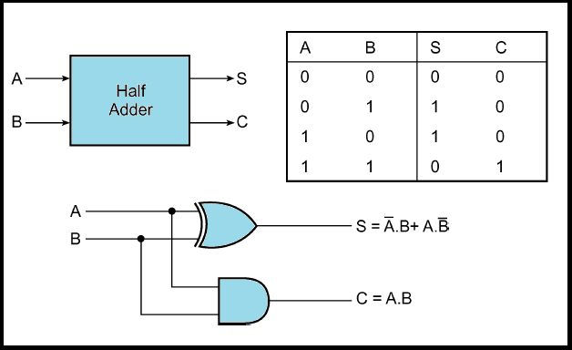
Example – Half Adder Implementation

Slide 33
Example – Half Adder Implementation
module HA (
output logic S,
output logic C,
input logic A,
input logic B
);
xor(S, A, B);
and(C, A, B);
endmodule

Slide 34
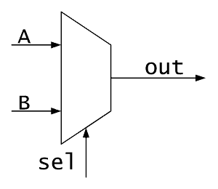
Module Instantiation Example
Build complex modules using simpler modules
What we have:
What we need:
A[1:0]
O
O[1:0]
B[1:0]
S
S

Slide 35
Module Instantiation Example
2-bit wide mux from two 1-bit muxes
Just “drawing” boxes and wires
A[1:0]
A]0[
O
O]0[
module mux2to1_2 (
output logic [1:0] O,
input logic [1:0] A,
input logic [1:0] B,
input logic S
);
mux2to1 mux0 (.O(O[0]), .S(S), .A(A[0]), .B(B[0]));
mux2to1 mux1 (.O(O[1]), .S(S), .A(A[1]), .B(B[1]));
endmodule
B]0[
O[1:0]
B[1:0]
S
A]1[
O
O]1[
B]1[
S
Input Port Name
Module Name
Instance Name
Input Port Assignment
S

Slide 36
The generate Command
Implementation of a 32-bit wide mux from 32 1-bit muxes using regular instantiation is long and exhausting…
Use generate
module mux2to1_32 (
output logic [31:0] O, // Output bits O
input logic [31:0] A, // Input bits A
input logic [31:0] B, // Input bits B
input logic S // Select
);
genvar i;
generate
for (i = 0; i < 32; i++)
begin
mux2to1 mux_inst(.O(O[i]), .S(S),
.A(A[i]), .B(B[i]));
end
endgenerate
endmodule

Slide 37
Agenda
Hardware Description Languages
SystemVerilog Building Blocks:
Modules
The logic data type
Vectors
Module implementation
Module instantiation
Test benches and simulation

Slide 38
SystemVerilog: design vs. simulation
Simulation = a way to test the design
Initial begin
#1 a = 1;
#3 b = 1;
#5 a = 0;
…
end

Slide 39
How Are Simulators Used?
Testbench generates stimuli and checks response
Testbench
Module Instance
(UUT)
Stimuli
Input1
Output1
.
.
.
.
.
.
Response
InputN
OutputM

Slide 40
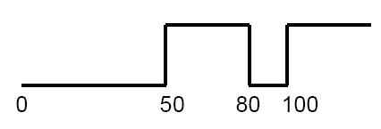
Test Bench - Generating Stimuli
Data: A sequence of values
initial begin
data = 0;
#50
data = 1;
#30
data = 0;
#20
data = 1;
end

Slide 41
Test Bench
module HA_tb;
logic ha_a;
logic ha_b;
logic ha_sum;
logic ha_carry;
HA uut (
.a(ha_a),
.b(ha_b),
.sum(ha_sum),
.carry(ha_carry)
);
initial begin
ha_a = 0;
ha_b = 0;
20#
ha_a = 1;
ha_b = 0;
20#
ha_a = 0;
ha_b = 1;
20#
ha_a = 1;
ha_b = 1;
end
endmodule
Stimuli Signals Creation
Tested Module Instantiation
Testbench
Input1
Module Instance
(UUT)
Output1
Stimuli
.
.
.
.
.
.
Stimuli Generation
InputN
OutputM

Slide 42
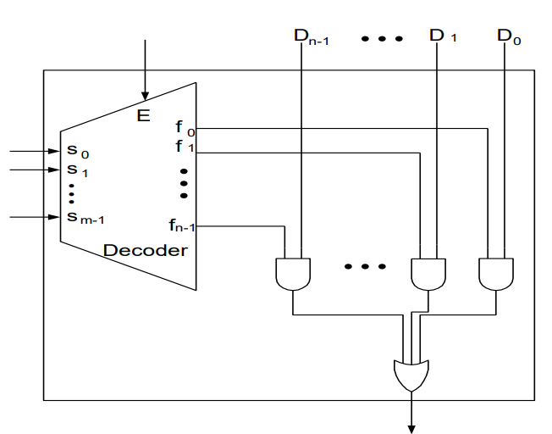
Mux Implementation using a Decoder

Slide 43
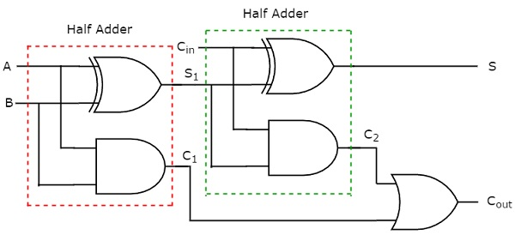
Full Adder Implementation using Two Half Adders

Slide 44

Wet Exercise 0
You will be required to:
Get to know ModelSim
Fix bugs in a HA implementation
Test it using a simulation
The videos are recommended
The workshops cover all the syntax needed to solve the wet exercise

Slide 45
Workshop #1 Cheat Sheet
Module:
Logic:
Logic values: 0, 1, x, z
Vector:
module my_module(
output logic ...,
input logic ...
);
... // declarations
... // description of a mux
endmodule
logic a, b, c, d;
logic [7:0] w1; // w1[7] is the MSB

Slide 46
Workshop #1 Cheat Sheet
Vector operations:
Bit select
Range select
Pack
Unpack
Repeated signals
w1[3]
w1[3:2]
vec = {x, y, z};
{carry, sum} = vec[1:0];
vec = {16{x}}; // 16 copies of x

Slide 47
Workshop #1 Cheat Sheet
Module instantiation:
Built-in logic gates:
module_name instance_name1 (
.out1(my_out1),
.out2(my_out2),
...,
.inN(my_in1)
);
not(O1, A);
nor(O2, A, B);

Slide 48
Workshop #1 Cheat Sheet
Generate:
genvar i;
generate
for (i = 0; i < 32; i++)
begin
mux2to1 mux_inst(.out(O[i]), .sel(sel),
.A(A[i]), .B(B[i]));
end
endgenerate

Slide 49
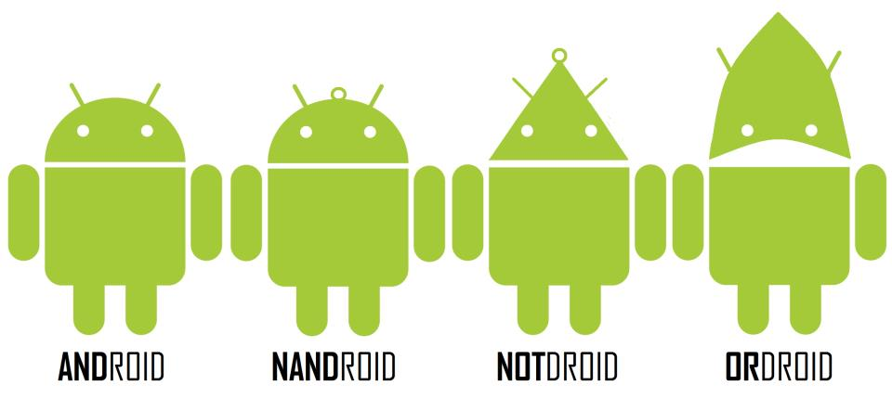
Questions?

